Slide 1
Differentially private reinforcement learning for the evolution of cooperation
Tao Zhang

Slide 2
Introduction
Preliminaries
Model description
Method
Experiment
Conclusion
Content

Slide 3


1. Introduction
The evolution of cooperation among individuals has been studied in social science, evolutionary biology and physics .

Slide 4
Problems & Challenges
Problems
1. There are diverse agents in the multiagent systems.
2. The excellent level of cooperation is easily affected by factors.
Challenges
How should the evolution of cooperation resist the impact caused by malicious agents in MAS?
How should the evolution of cooperation adapt in various scenarios?

Slide 5
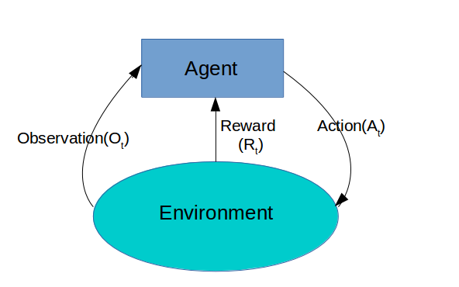
2. Preliminaries
Reinforcement learning
RL is a type of machine learning techniques that enables agents to learn in an interactive environment by trial and error, using feedback from their own actions and experiences.
Q-learning: a value-based RL algorithm that is used to find the optimal action-selection policy π(s, a) using a Q-function.

Slide 6
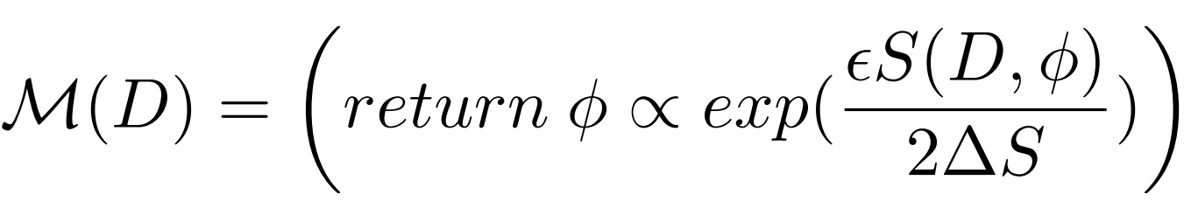
Differential privacy
A randomized algorithm M satisfies -differential privacy if for any input pair of D and D’, and for any possible outcome f(D) Ω,
Exponential mechanism
Given score function S(D, φ) of a dataset D, the exponential mechanism M satisfies
-differential privacy if
where score function S(D, φ) is used to evaluate the quality of an output φ and ∆S is the sensitivity.

Slide 7
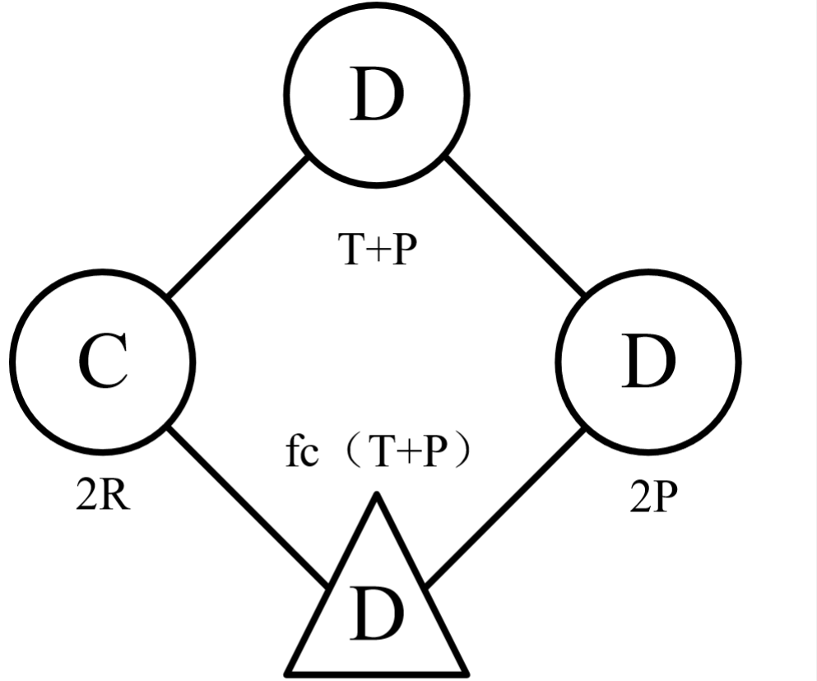
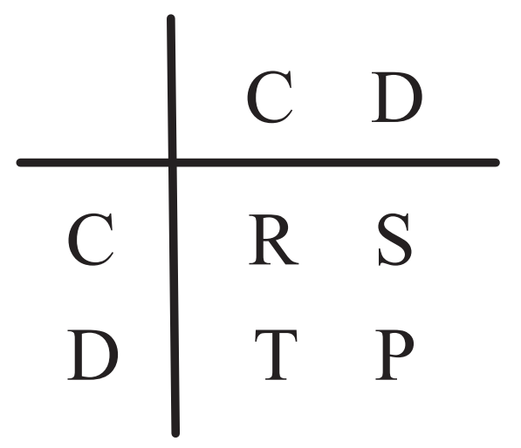
3. Model description
(b) Payoff matrix
Figure 1: (a) Interactions between
diverse agents in the PD game
1) T > R > P > S 2) 2R > T + S.

Slide 8
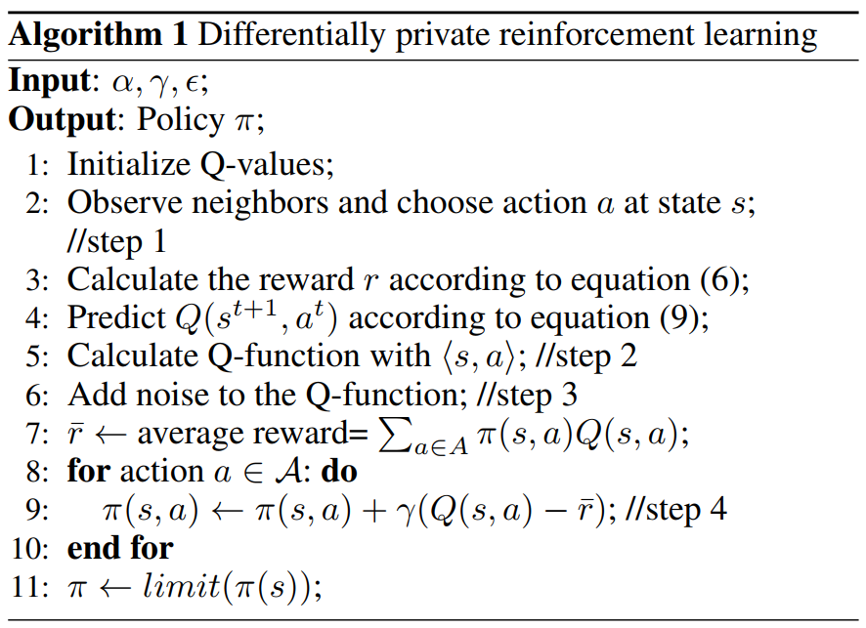
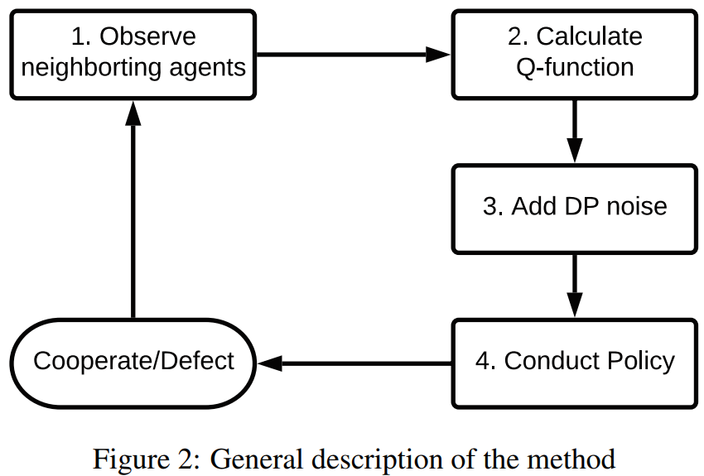
4. Method
Overview of the DP-RL mechanism

Slide 9
The design of the Q-function
Reward r
Current Q-value
Maximum expected
future reward

Slide 10
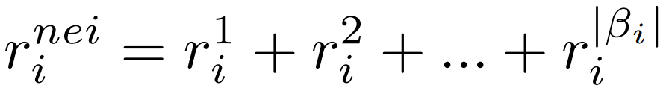
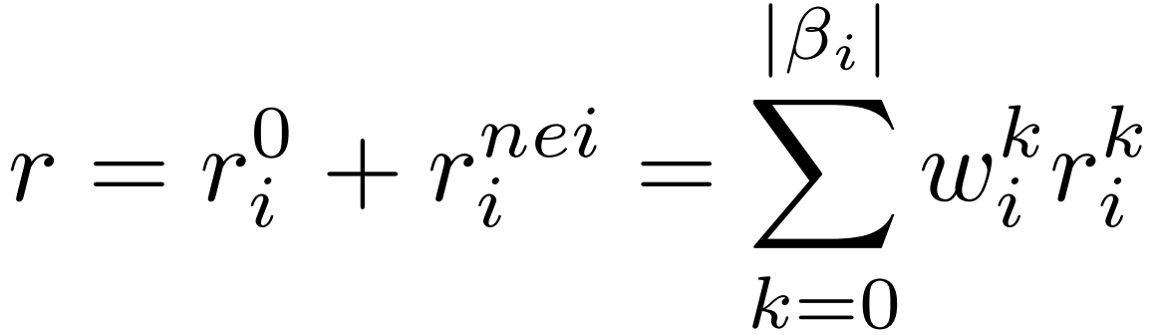
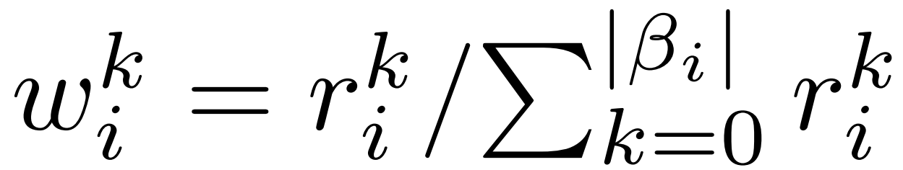
The second part Reward r consists of two components
1) The first component is the reward that the agent i receives from its neighbors
2) The second component is the reward that the neighbors of agent i receive
we use importance weight w to balance the scale.
, where

Slide 11
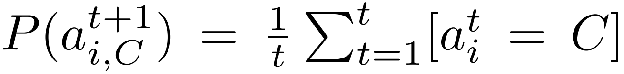
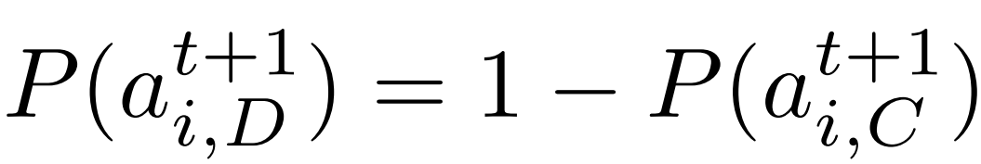
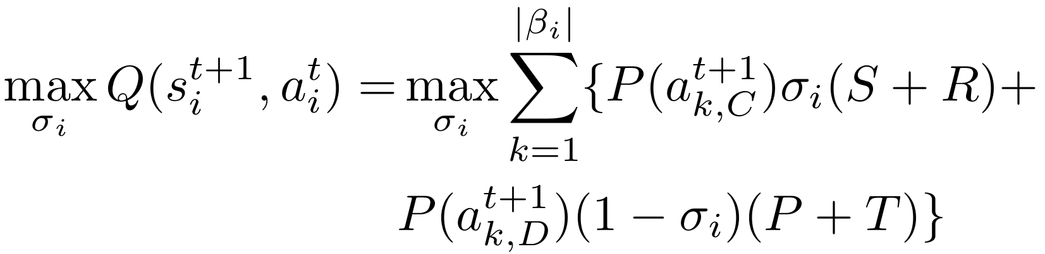
The third part The maximum expected future reward is given by the new state s^{t+1} and all possible actions at that state.
The estimated probability of choosing to cooperate or defect in next action can be presented:
The maximum expected reward:

Slide 12
The application of differential privacy
Privacy budget
Score function
Sensitivity

Slide 13
Discussion
Why the proposed scheme can adapt in various situations?
Why DP can resist the impact of malicious agent?

Slide 14
5. Theoretical analysis
Theorem 1 The proposed RL method satisfies -differential privacy
Lemma 1 The scale of adjusted importance weight is smaller than the scale of interference importance weight
Theorem 2 Algorithm 1 improves the level of cooperation when malicious agents are involved in MAS.

Slide 15
Experiment
Baselines
Imitate-Best-Neighbor (IBN), where each agent imitates the action of the wealthiest agent (including itself) in the next round
Imitate-Best-Strategy (IBS), where agents adopts the strategy that accumulates the highest payoff in its neighborhood
Local-Redistribution-Strategy (LRS), where agents share a fraction of their income with neighbors
Networks
Homogeneous network, Random network and Scale-free network

Slide 16
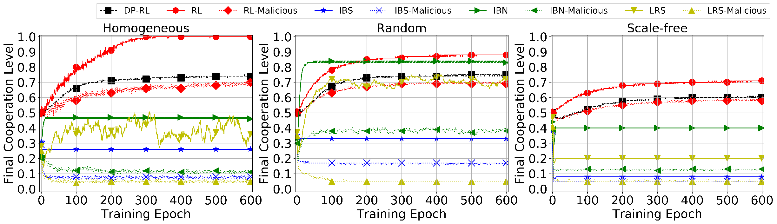
Experiments for stability
Figure 3: The stability to resist the impact by malicious agents for four mechanisms

Slide 17
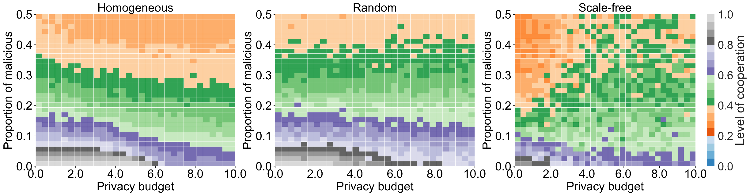
Figure 4: The impact of varying privacy budgets and the proportion of malicious agents on the evolution of cooperation

Slide 18
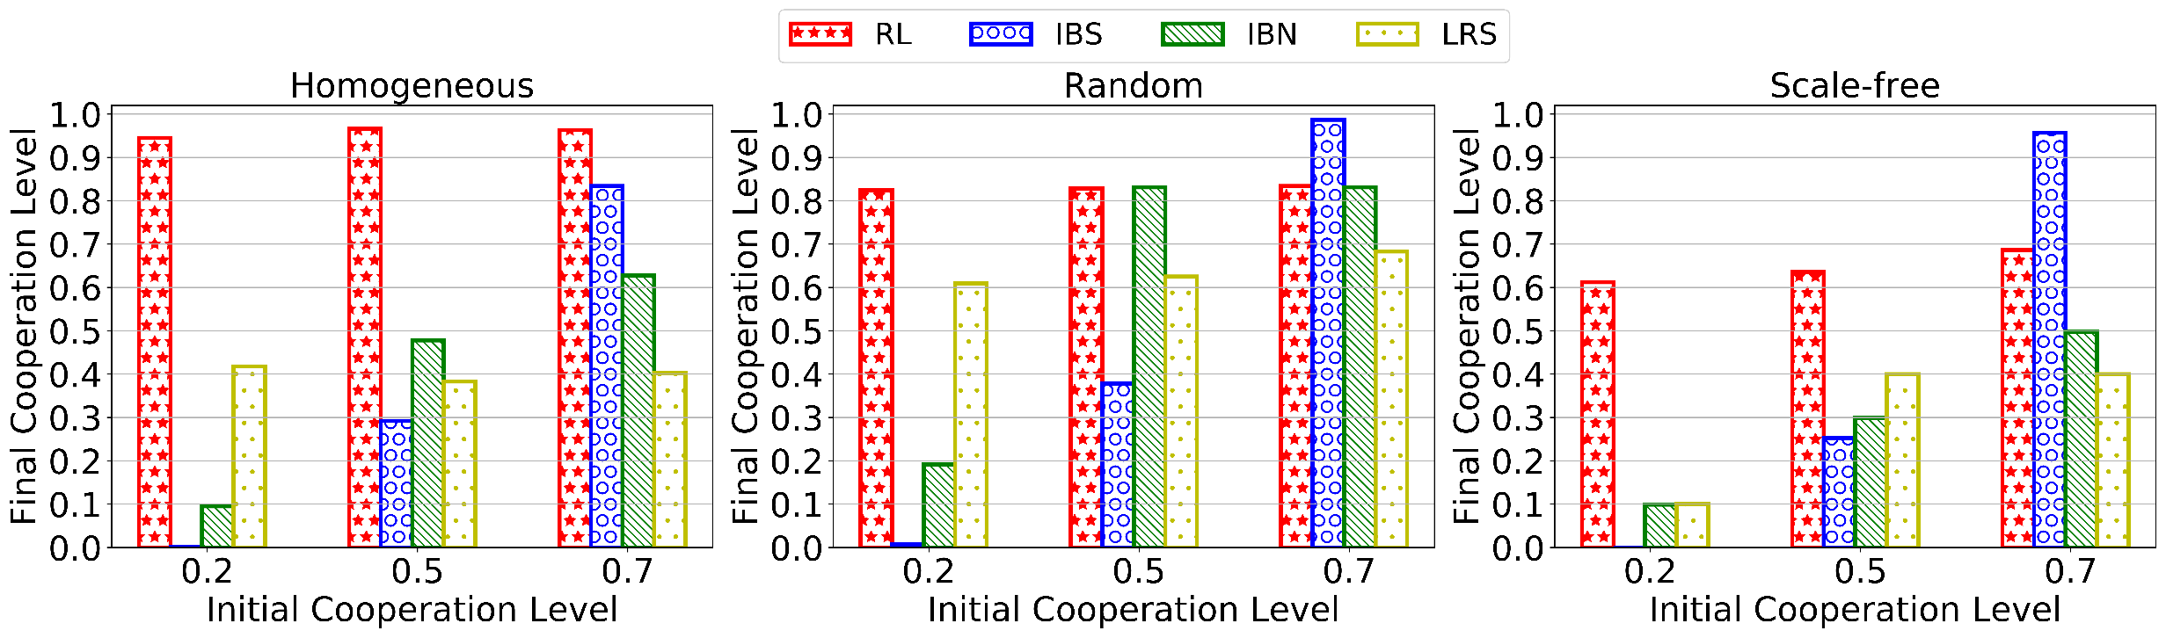
Experiments for adaptivity
Figure 5: The adaptivity on structured networks and initial proportion of cooperators for four mechanisms

Slide 19
Conclusion
We design a reinforcement learning mechanism to make agents learn how to make actions in the evolution of cooperation. This provides a desirable adaptivity to fit various conditions in MAS.
We apply differential privacy to reinforcement learning to adjust the agents’ action in order to resist the impact of malicious agents. This provides a desirable stability to resist the impact of malicious agents.

Slide 20
Thank you

